Slide 1
Welcome

Slide 2
Getting Started with DataSunday

Slide 3
What is DataSunday ?
DataSunday is an shopify app which helps you to collect e-commerce product and create into shopify store. Seamless to collect Taobao, Tmall, Amazon, ebay product information, product image, merchant information, transaction history and customer feedback. You can create that products into your shopify store, can set pricing rules for products and many more.

Slide 4
Contents
Get the Product
How to use it
Set the Pricing Rule
Create Product in your store
Plan Pricing and Features.

Slide 5
Get the Product
There are two ways to get the products :
Install as a Chrome extension
Import from CSV file

Slide 6
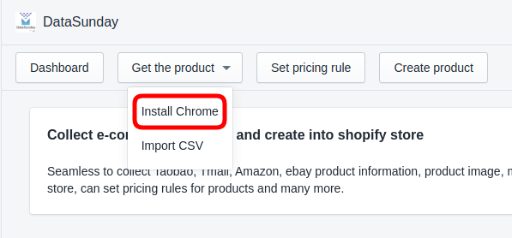
Install as a Chrome extension
To install as a Chrome extension, go to the Get the product -> Install chrome

Slide 7
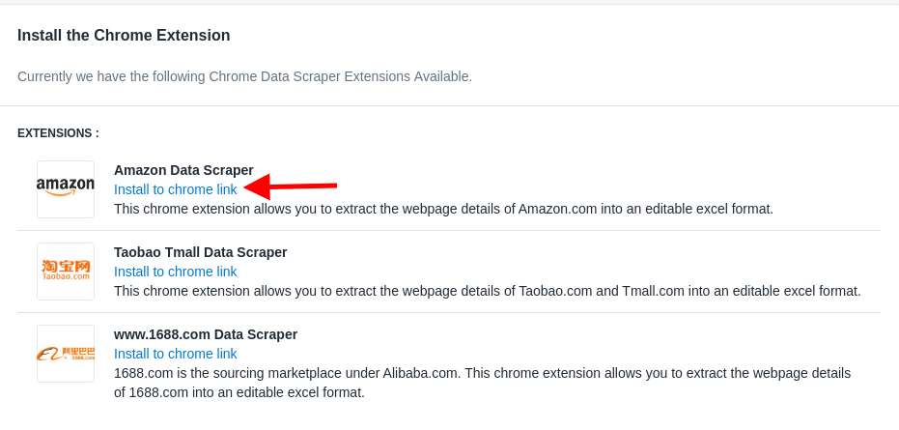
Install as a Chrome extension
Now select the Online store, from where the data have to be scrapped by clicking on the Install to chrome link

Slide 8
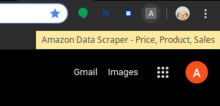
Install as a Chrome extension
After clicking on the link, zip file of the extension will be downloaded. Add the extension to the chrome by load unpacked. Now you will be able to use the extension.

Slide 9
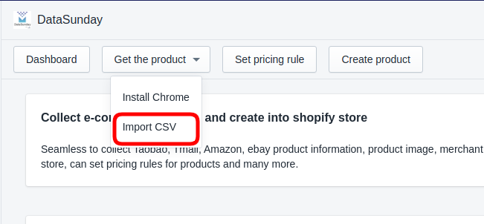
Import CSV
To import product data from the CSV file, go to the
Get the product -> Import CSV

Slide 10
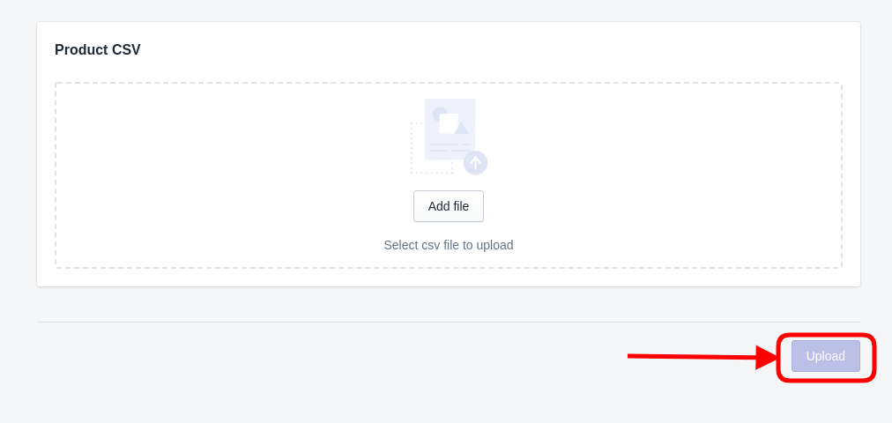
Import CSV
Now Add the CSV File, from your computer and click on upload button

Slide 11
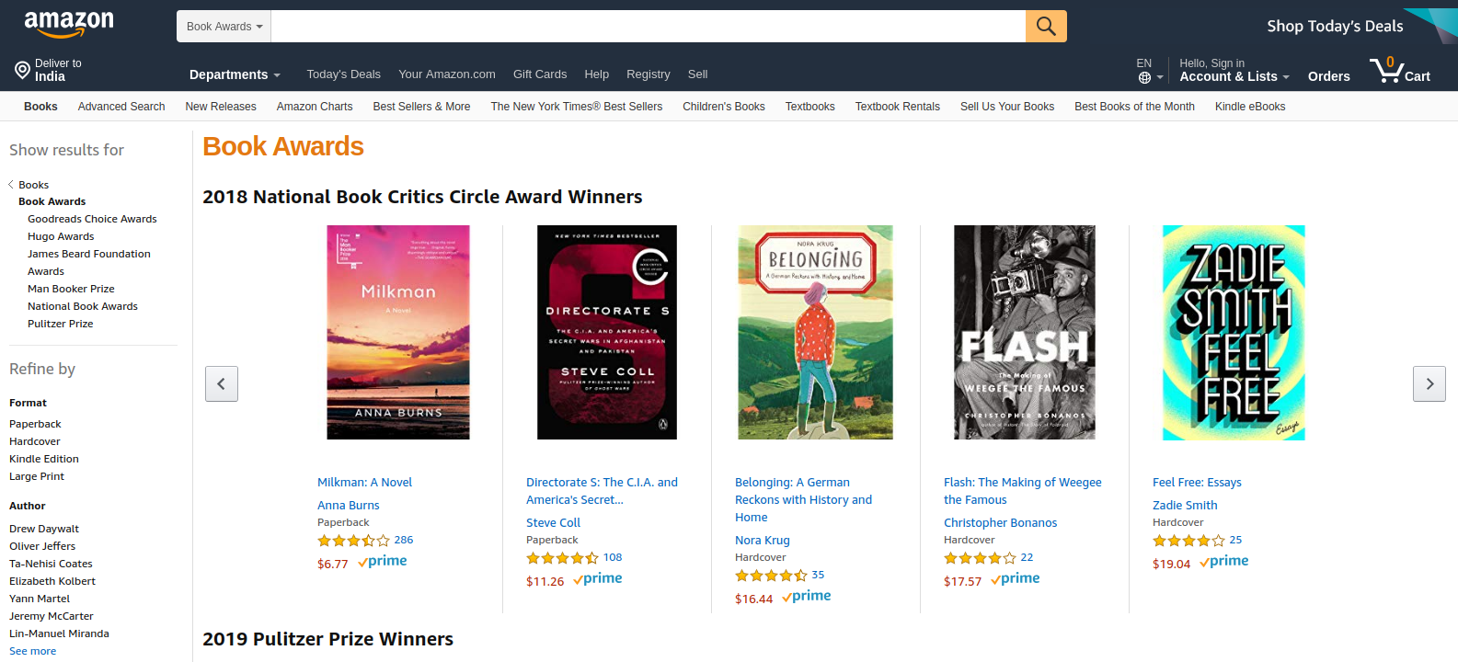
How to use it?
First, login to your shopify shop and on a new tab, open the category page of website from where you want the data.
Make sure both the tabs are open in the same browser window. Like this -

Slide 12
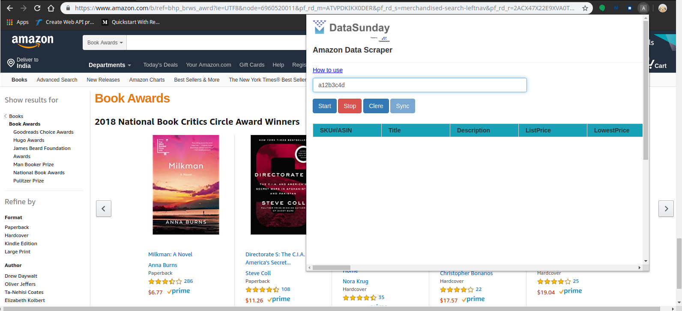
How to use it?
Now, open the extension and enter the access key.

Slide 13
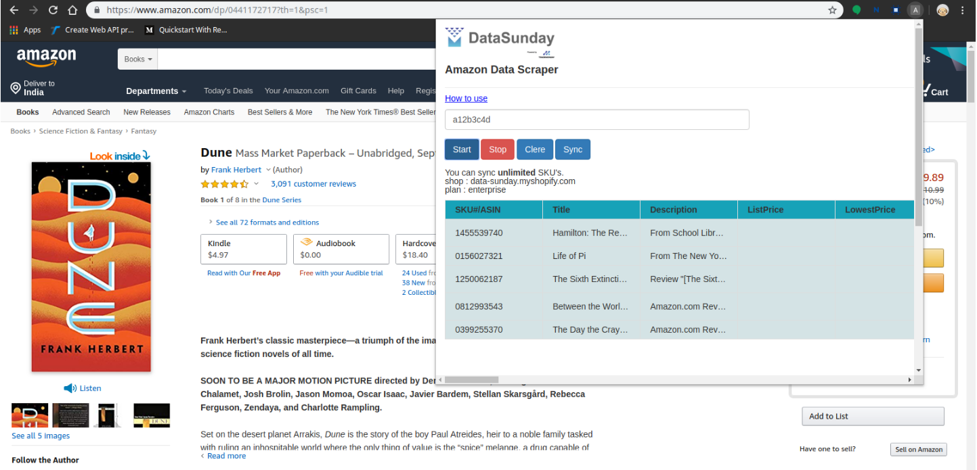
How to use it?
To start the process, click on the Start button and the extension will start to scrap the data.

Slide 14
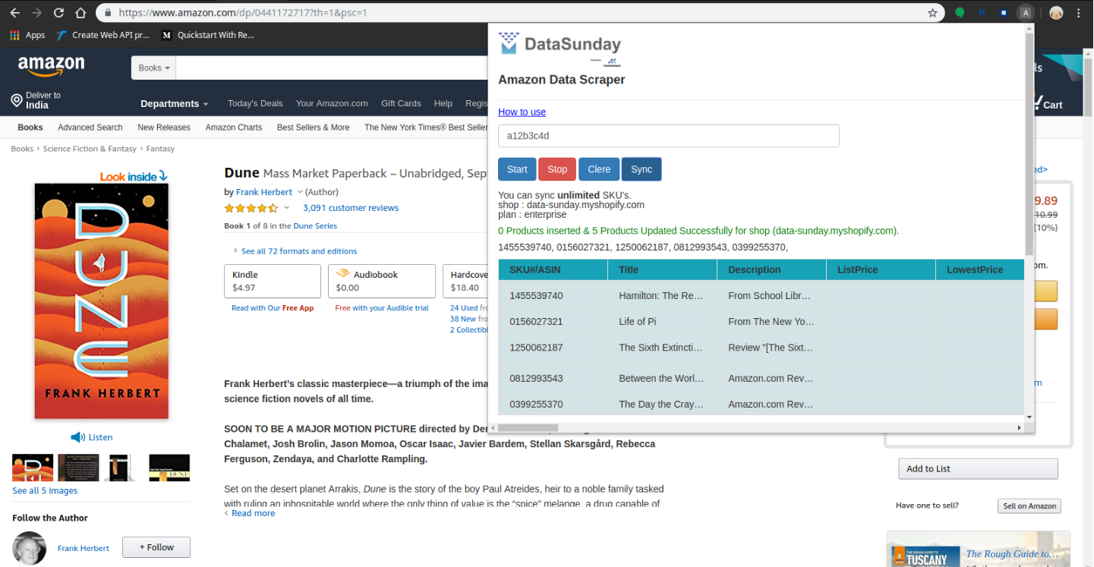
How to use it?
To stop and sync the scrapped data with the app, click on the Sync button.

Slide 15
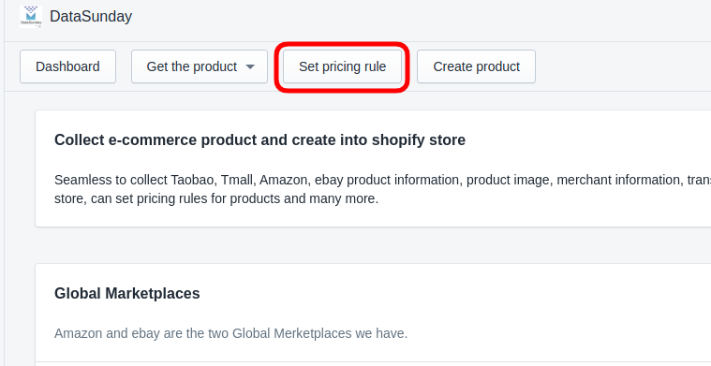
Set the Pricing Rule
This option is used to set the pricing rule for the products of the store.
To set the pricing rule, click on the Set pricing rule

Slide 16
Set the Pricing Rule
You will see, there are two types of price rule.
1. Global
2. Product tag wise

Slide 17
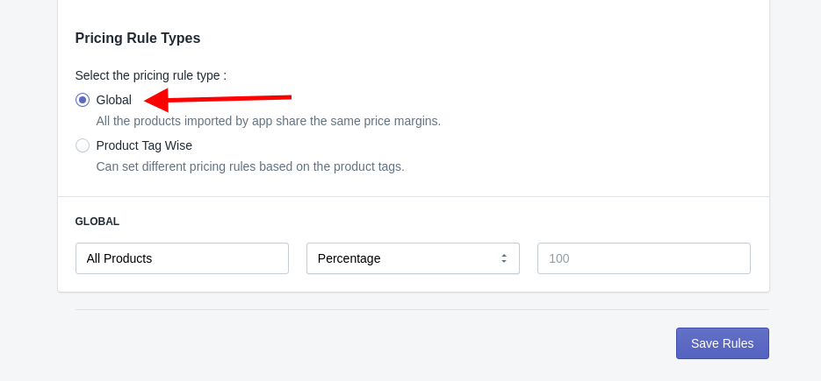
Global Pricing Rule
In Global, all the products imported by app share the same price margins.

Slide 18
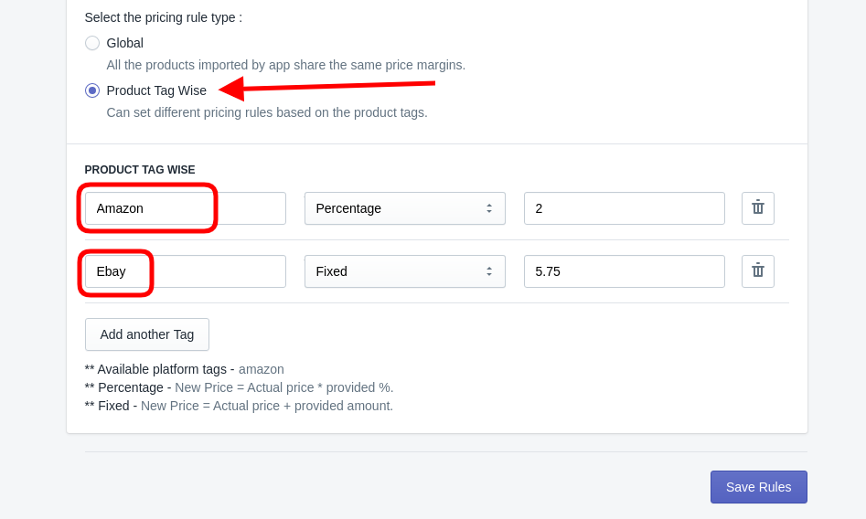
Product tag wise Pricing Rule
In Product tag wise, can set different pricing rules based on the product tags (parent store).

Slide 19
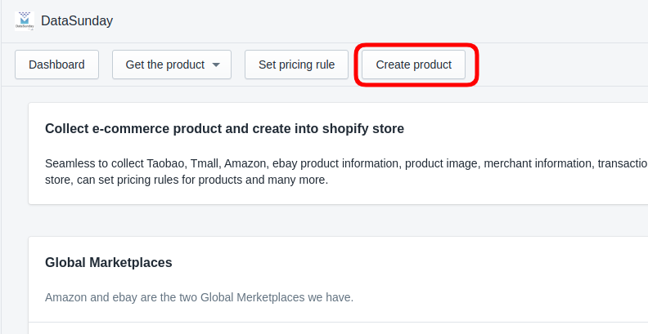
Create Product
In Product tag wise, can set different pricing rules based on the product tags (parent store).

Slide 20
Create Product
You will see all the scrapped products.
There are three filters given :
Not Created
Already Created
Show All

Slide 21
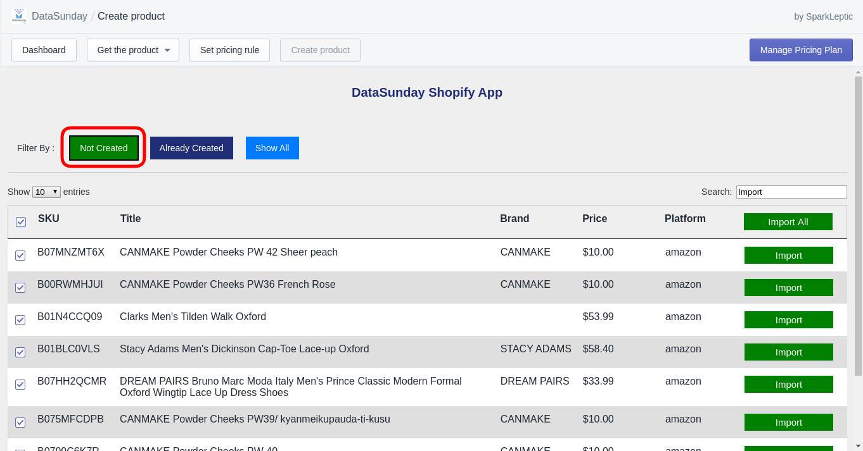
Create Product shows : Not Created
Not Created filter shows all the products that are stored in database but not created in the shop.

Slide 22
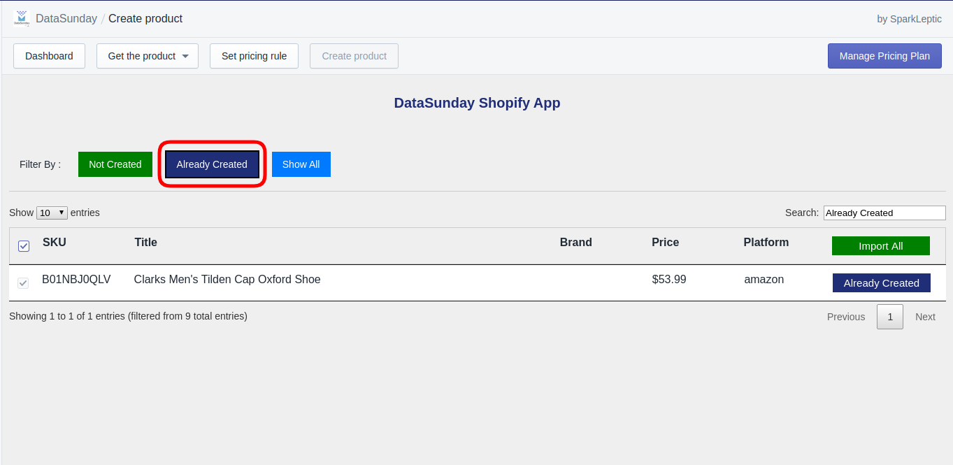
Create Product shows : Already Created
Already Created filter shows all the products that are stored in database and also created in the shop.

Slide 23
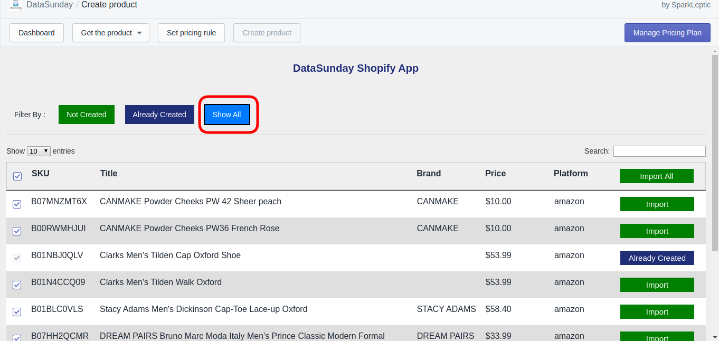
Create Product shows : Show All
Show All filter shows all the products that are stored in database.

Slide 24
Create Product
To create product, you need to click the
Import All or Import button.

Slide 25
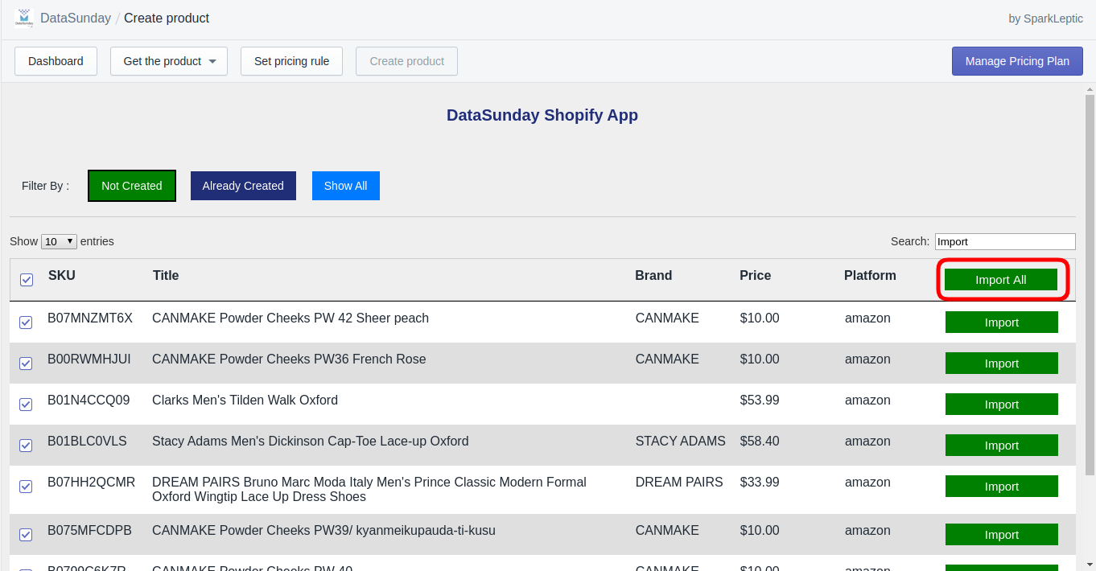
Create Product :Import All
Import All button create all the products in the shop that are stored in the database

Slide 26
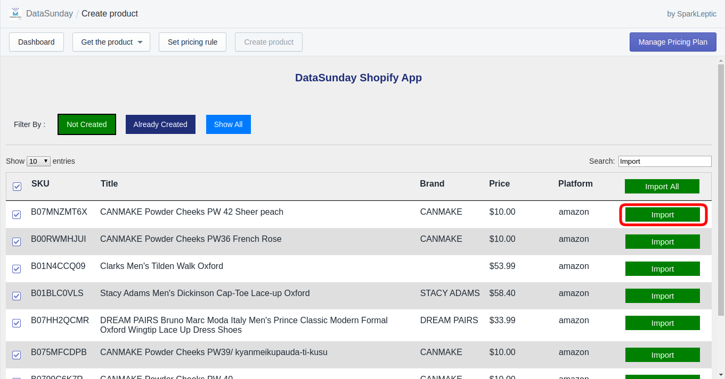
Create Product :Import
Import button only create that product in the shop whose Import button is being clicked

Slide 27
Plan Pricing and Features
This shows the various plans and their features and prices.
To view various plans, click on the Manage Pricing Plan in the dashboard.
There are currently four plans available -
Free Plan (Trial)
Lite
Enterprise
Professional

Slide 28
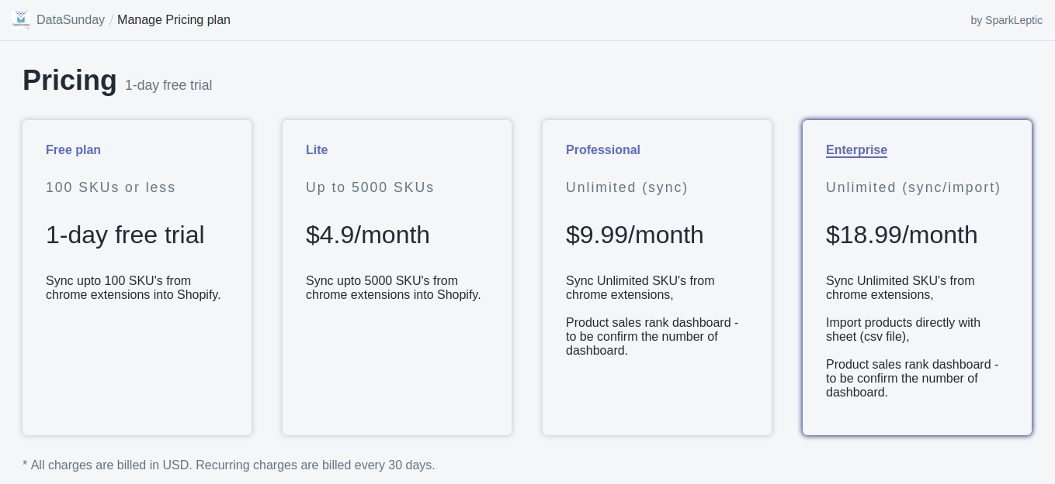
Plan Pricing and Features
There features and pricing is given below :

Slide 29
Dashboard
In the Dashboard section of the app, Reports of the store can also be seen.
The detailing of the report varies from the plan that the store have.

Slide 30
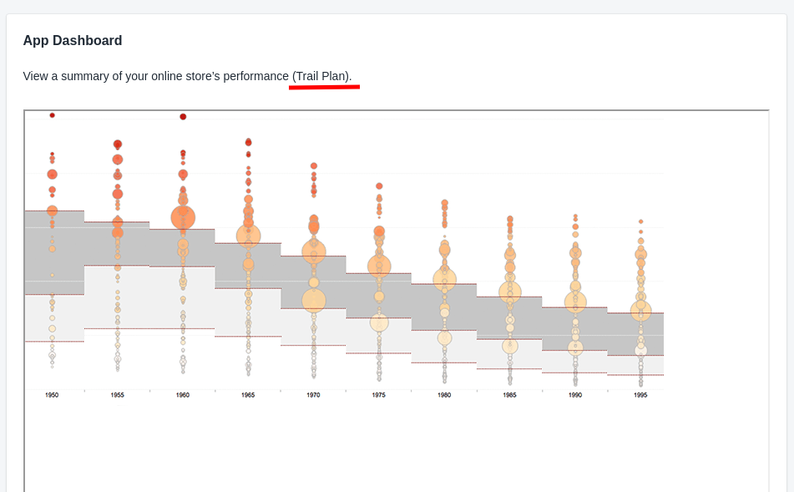
Dashboard of the Trial plan :

Slide 31
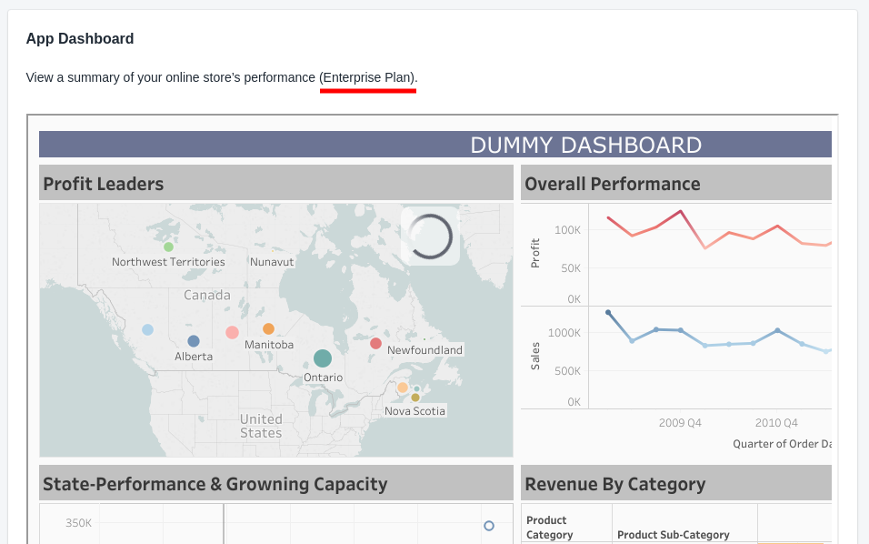
Dashboard of the Enterprise plan:

Slide 32
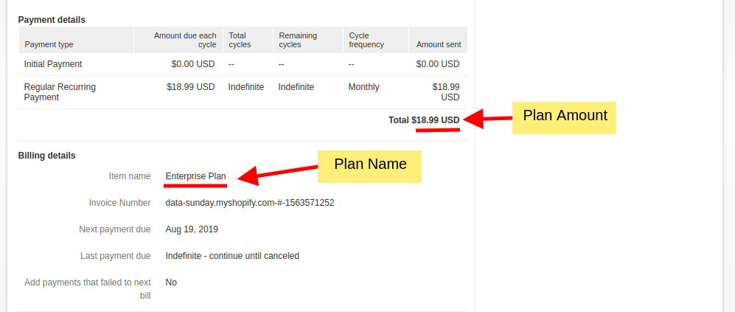
payment details
In the payment details section of transaction in PayPal, we can easily see the plan details.
Like this -

Slide 33


Slide 34


